Slide 1
Enhancing Account Sales Performance through Data-Driven Insights

Slide 2
Uncovering Opportunities and Optimizing Sales Strategies
This presentation will explore key insights from our account sales analysis, highlighting areas for improvement and providing actionable recommendations to boost sales performance.

Slide 3
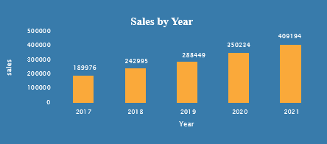
Sales Over 5 Years
The bar graph depicts a clear upward trend in sales from 2017 to 2021. Sales experienced a significant jump between 2017 and 2018, followed by a steady increase until 2021, where they reached a peak.
Recommendations-
Maintain Growth Momentum: Continue implementing strategies that drove the impressive sales growth in 2021.
Explore opportunities to expand into new product lines or markets to reduce reliance on a single year's performance.
Focus on building strong customer relationships and loyalty to ensure continued sales growth in the coming years..

Slide 4
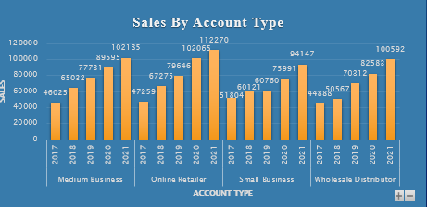
Sales Performance Overview
The graph shows sales trends from 2017 to 2021 for four account types: Medium Business, Online Retailer, Small Business, and Wholesale Distributor. Online Retailer consistently generated the highest sales, followed by Medium Business. Small Business sales fluctuated, while Wholesale Distributor sales showed moderate growth.
Recommendations-
Focus on Online Retailers: Further analyze factors driving online retailer success to replicate strategies across other account types.
Address Wholesale Distributor Challenges: Investigate reasons for low sales in this segment and implement targeted strategies to boost performance.

Slide 5
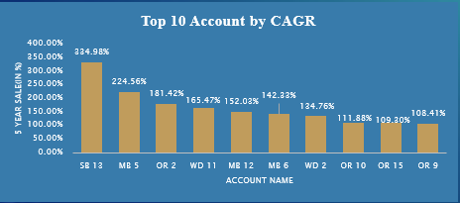
Account by the sale
The graph shows the top 10 accounts by Compound Annual Growth Rate (CAGR) over a 5-year period. The x-axis represents the account names, while the y-axis represents the CAGR in percentage. Account SB 13 has the highest CAGR at 334.98%, followed by MB 5 at 224.56%. The remaining accounts show varying levels of growth, with OR 9 having the lowest CAGR at 108.41%.
Recommendations-
Analyze High-Performing Accounts: Conduct a detailed analysis of SB 13 and MB 5 to understand the factors driving their exceptional growth. Identify replicable strategies for other accounts.
Address Underperforming Accounts: Investigate the reasons for lower CAGRs in accounts like OR 9 and OR 15. Develop targeted improvement plans to enhance their performance.

Slide 6
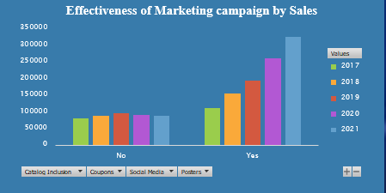
Performance of Marketing Campaign by sales
The graph shows the effectiveness of different marketing campaigns (Catalog Inclusion, Coupons, Social Media, and Posters) on sales from 2017 to 2021. Sales generally increased with marketing campaigns, especially with Social Media and Posters.
Recommendations-
Prioritize Social Media and Posters: Increase investment in Social Media and Poster campaigns as they have shown the highest impact on sales.
Evaluate Catalog Inclusion and Coupons: Analyze the cost-effectiveness of Catalog Inclusion and Coupons. Consider reducing spending if their impact on sales is not significant.

Slide 7
Thank You

